Slide 1
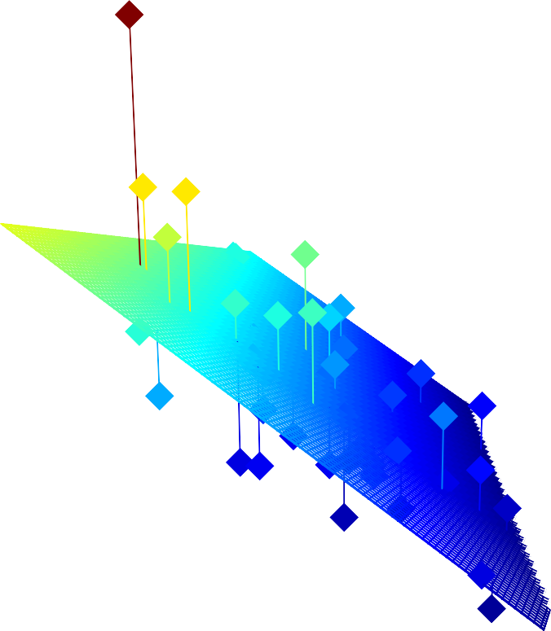
40,000
Predisinfection E. coli (cfu/mL)
40,000
30,000
30,000
Predisinfection E. coli
20,000
20,000
60
40
10,000
10,000
CT
2.5
20
Log removal
2.0

